Slide 1
Adversarial Propagation Detection Of Fake News on Social Media
By Vishal Uniyal 12103584
Notes:
Introduce
Studying – 2 years
Previously done batchelors of software
I have worked as IT systems administrator for 3 years

Slide 2
Table of Contents
Introduction – Fake News Propagation in Social Media
Background – Previous Actions
Related work
Motivation
Adversarial Learning
Propagation
Concurrent Research
Further Research Opportunities
Notes:
We will talk about what is fake news and what is machine learning and the impacts
How and why it has motivated to me to take up this topic,
Briefly talk about the back ground of fake new detection.
What adversarial learning what are the types of propogration
Transferability of attacks in simple terms reach the highest efficiency
Future research opportunities & progress report

Slide 3
Introduction
COMPREHENSIVE REVIEW ON FAKE NEWS AND NEURAL NETWORKS

Slide 4
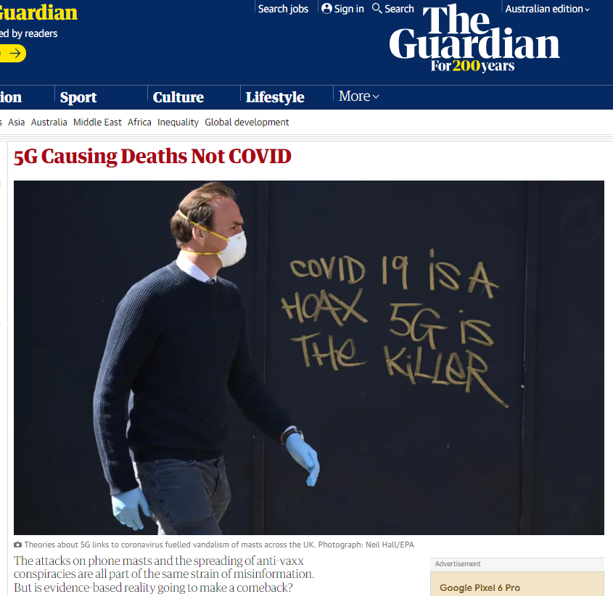
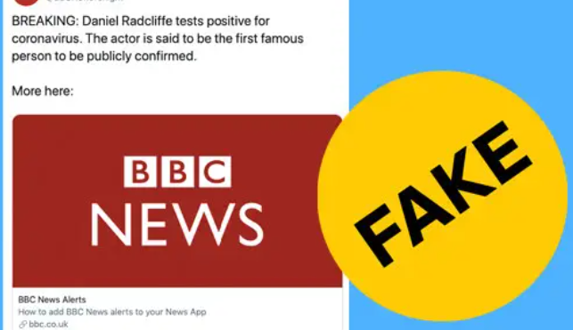
What is Fake News?
“false stories that appear to be news, spread on the Internet or using other media, usually created to influence political views or as a joke”**
Notes:
On January 20 post floated that the millimeter wave spectrum used by 5G technology and Covid-19. The article was taken down within hours, but the theory had already spread to English-language Facebook pages. There’s been a crowd that has been saying that 5G is harmful to human health for years, ever since 5G was first being proposed [and] well before any towers or networks were online

Slide 5
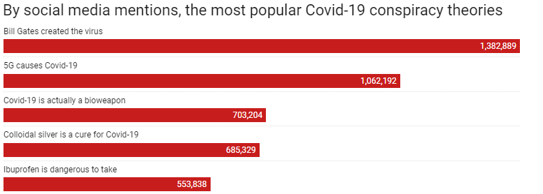
Social Media Engagement
FAKE NEWS Articles | Publishing Website | Social Media Engagements | Impact
Obama signs a nationwide order banning The Pledge of Allegiance in Schools | abcnews.com.co | 2.2 million | Defaming US Democratic Party during elections
Obama cut $2.6 billion from programs for vet-erans to support Syrian refugees in the US | endingthefed.com | 1.7 million | Defaming US Democratic Party during elections
Ireland is officially accepting Trump refugees from America | winningdemocrats.com | 817,900 | Loss of Political Stance and leadership toward republicans
Hillary Clinton sold weapons to ISIS and it was confirmed by WikiLeaks | thepoliticalinsider.com | 789,500 | Change in election stance
Daniel Radcliffe Tests Positive for Corona Virus | BBC.com | 762,000 | Loss of reliability of Popular news channels
Heilweil, R. (2020, April 24). The conspiracy theory about 5G causing coronavirus, explained. Vox. https://www.vox.com/recode/2020/4/24/21231085/coronavirus-5g-conspiracy-theory-covid-facebook-youtube
Notes:
According to Zignal Labs data, the conspiracy theory about Bill Gates and coronavirus has been mentioned at least 1,382,889 times online. 5G causes Covid -19 about 1M times. This data includes social media information collected between January, 2020 and April, 2020. As coronavirus conspiracy theories have grown, tech platforms have become more aggressive. But none of them has completely conquered the problem of suppressing false information about the coronavirus pandemic, especially as it relates to 5G technology.

Slide 6

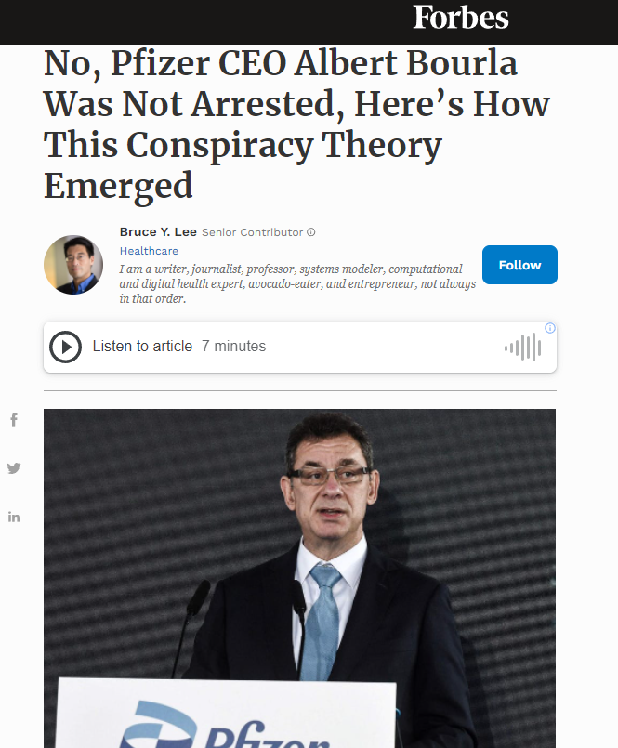
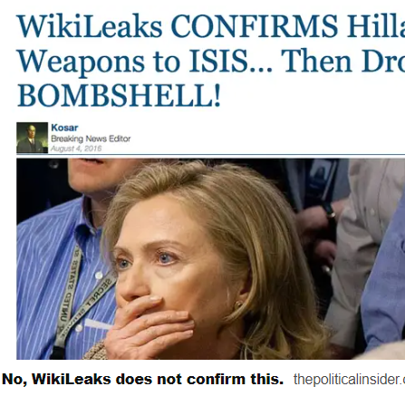

unPopular Fake News
**Fake News. (2018). In Cambridge online dictionary. Retrieved from https://dictionary.cambridge.org/us/dictionary/english/fake-news
Notes:
Fake news is false stories that appear to be news, spread on the Internet or using other media, usually created to influence political views or as a joke.
Hillary Clinton sold weapons to ISIS and it was confirmed by WikiLeaks This stemmed from a number of social media users who posted that one of the Wikileaks emails from "The Podesta Emails" proved Hillary Clinton had "sold weapons to ISIS,“ there were just ordinary set of emails sent by hilary Clinton, Hillary Clinton suggested Trump should run for President which obviously she didn’t say but it did create a stir in the social media.
We have another Fake news article shared on twiter stating CEO of Pfizer has been arrested and charge with fraud - CEO Albert Bourla was arrested for misrepresenting the effectiveness of his company’s vaccine. Then you have another news that His name also did not appear in a search of the state’s court system.

Slide 7
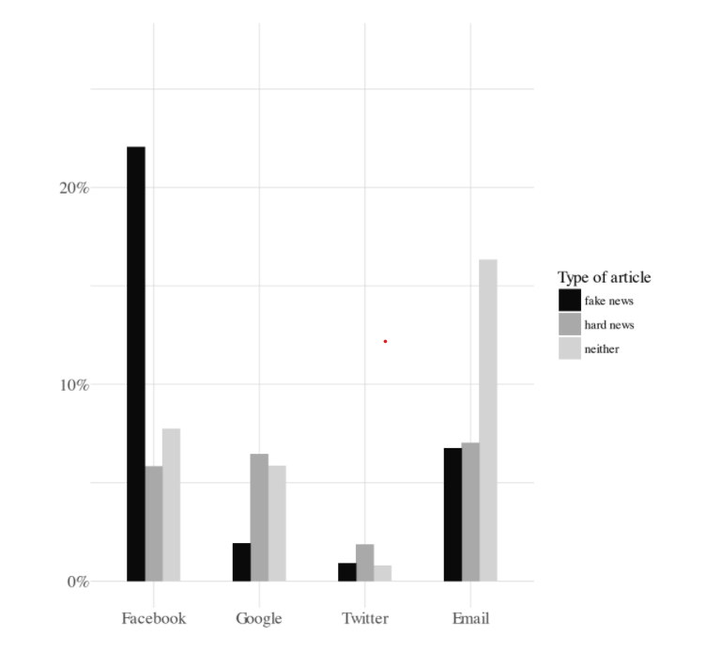
Statistics of Fake News Propagation
The Graph Show the level of propagation in Various social media Platforms.
The Fake New, Hard News(Biased News) & Neither(True News) Classification Fake.
Facebook shows the highest leap in Fake News.
Our focal point this research is in the detection of fake news in Facebook.
Notes:
Facebook google twiter email , Next time Iwill also include Wiebo platform as well to compare the number of fake news articles shared on the this platform.

Slide 8
Background

Slide 9
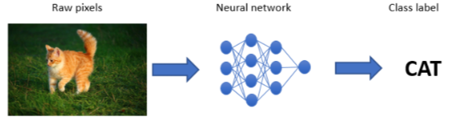

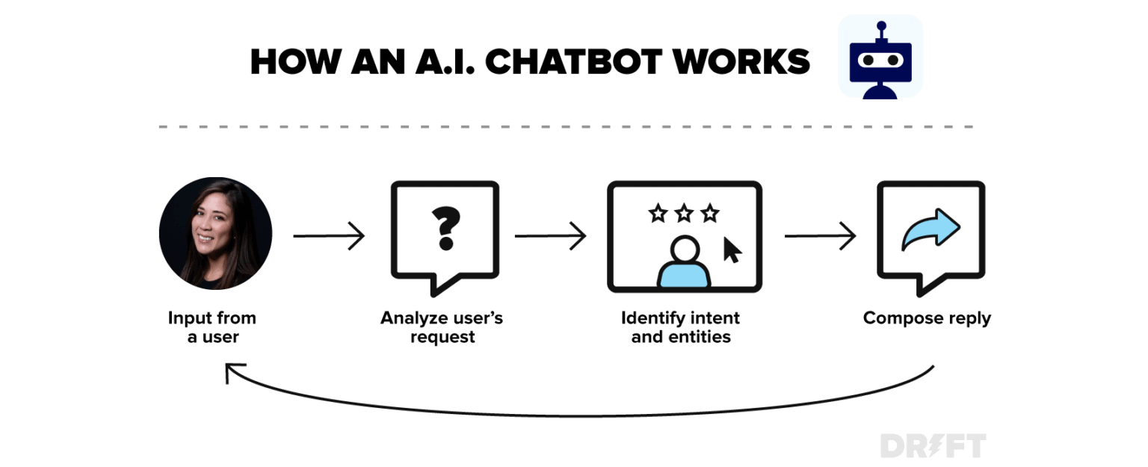
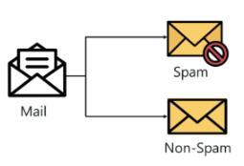
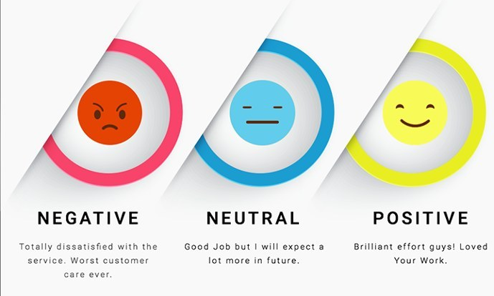
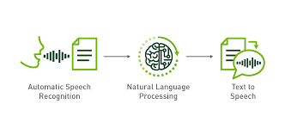
Deep Neural Networks
An artificial neural network (ANN) is an aspect of AI that is focused on emulating the learning approach that humans use to gain certain types of knowledge. Like biological neurons, which are present in the brain, ANN also contains several artificial neurons, and uses them to identify and store information
Image Classification
Chatbots
Spam Filtering
Sentimental Analysis
Speech ← Text
Notes:
An artificial neural network (ANN) is an aspect of AI that is focused on emulating the learning approach that humans use to gain certain types of knowledge. Like biological neurons, which are present in the brain, ANN also contains several artificial neurons, and uses them to identify and store information.
We have some Natural processing language techniques used and some are used in our day to day lives,
so we have Image classification where there is a picture of a cat but for computer vision is just array of pixels but fed into a neural network which is able to label it in text.
Spam filtering which uses ML classifiers and classifies on basis of subject, body and images on an email, comparing it from an approved dataset.
Sentimental analysis helps to classify for Positive negative emotions conveyed in a text or conveyed to the reader of an article.
Similar classifications algorithms of DNN are used in Chatbots and Speech to text and text to speech recognition.

Slide 10
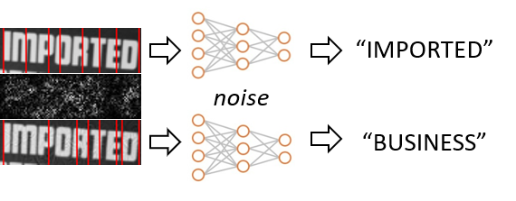
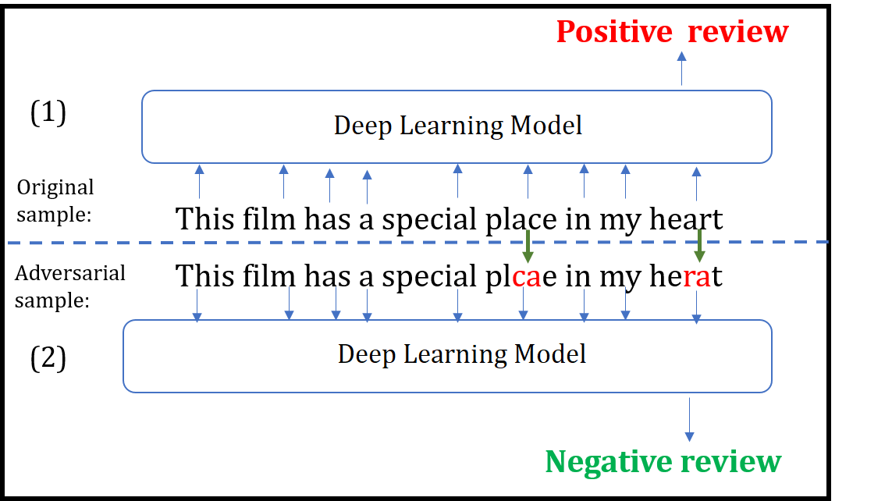
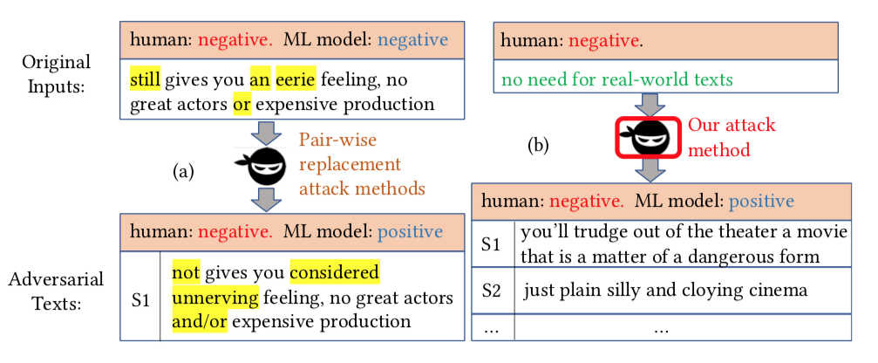
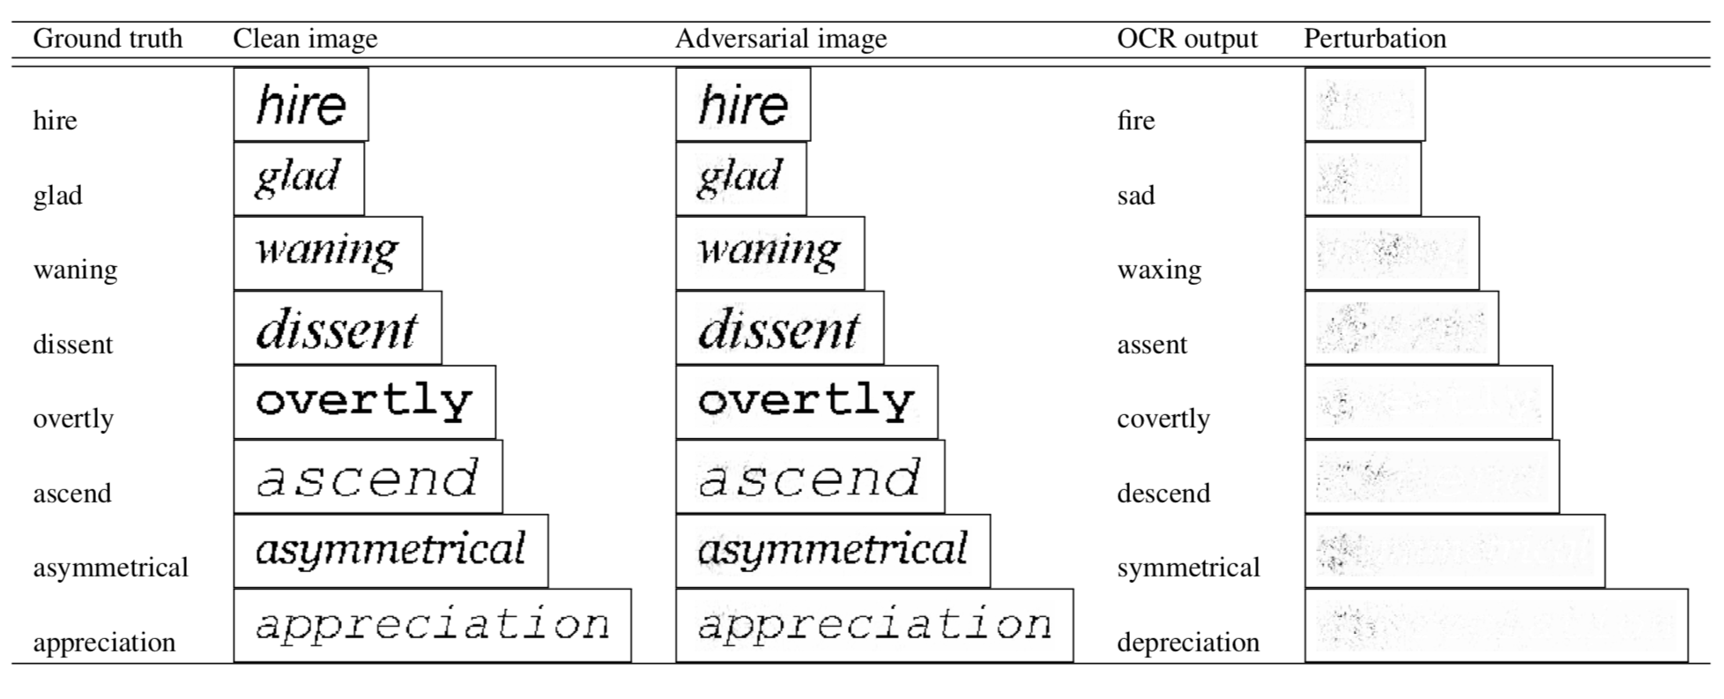
Adversarial Learning
‘Introduction of ‘Attacks’ into machine learning model to manipulate the outcome’
Comes in Various kinds of models :-
I. Text Classification - Adversarial text for NLP models.
II. Image Classification –Perturbation in text images & images.
III. Sentimental Analysis – Change in Sentiments.
Notes:
Manipulates the outcome of the classifier

Slide 11
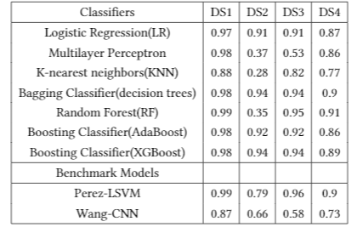
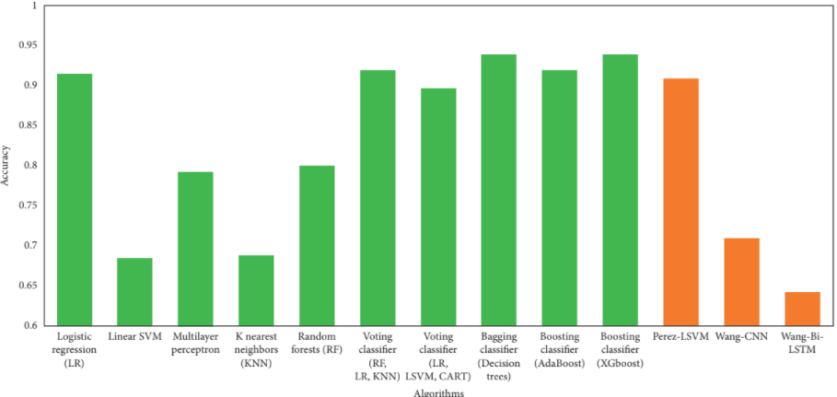
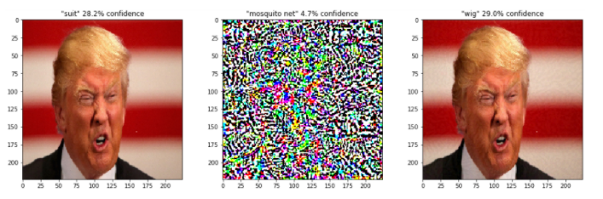
EFFICIENCY OF TRADITIONAL CLASSIFIERS
Notes:
Benchmark algorithms Wang-CNN and Wang-Bi-LSTM performed poorer than all other algorithms. On DS2, bagging classifier (decision trees) and
boosting classifier (XGBoost) are the best performing algorithms, achieving an accuracy of 94%. Interestingly, linear
SVM, random forest, and Perez-LSVM performed poorly on DS2. Individual learners reported an accuracy of 47.75%, whereas ensemble learners’ accuracy is 81.5%.

Slide 12
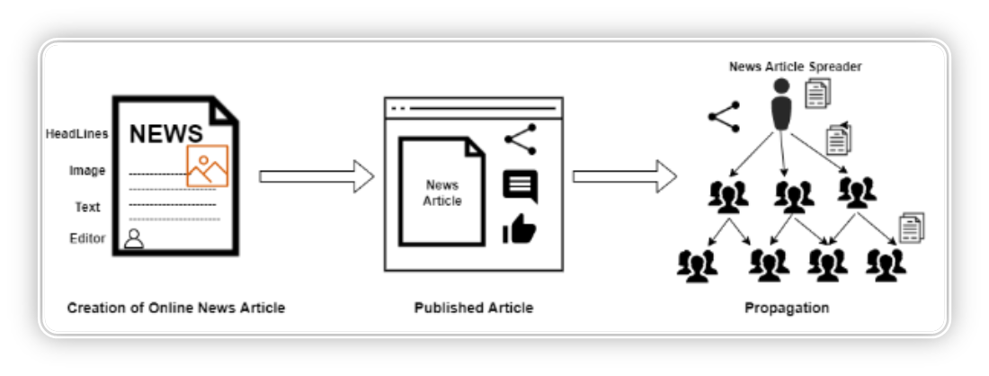
Motivation
Building Robust Classifier: With the help of adversarial learning and modern-day ML detect practices, my goal is to build a model that can efficiently detect through new fake news articles and question their originality.
Spam Detection: Enable other researcher to use this knowledge to implement in Spam detection. Spam detecting is in many ways like Fake News Article Detection technique.
Awareness: Spreading awareness to the readers and help them utilize this feature of fake news detection derecognize the originality and severity of the content.
Notes:
The purpose of this study is to detect fake news more efficiently than prevailing detection techniques can. As I read current day research, I found detection strategy insufficient for accurately finding fake news article online. As world’s technical sector is advancing current day techniques are becoming easy to spread false rumors, misinformation and deception without getting detected. Adversarial Learning techniques are modern techniques, these training ML Models have show the highest accuracy in predicting outcome. I have decided to take use Adversarial learning methodology with current day fake news detection technique
Building Robust Classifier: my goal is to build a model that can efficiently detect through new fake news articles and question their originality.
Spam Detection: Spam detecting is in many ways like Fake News Article Detection technique. So, I will help other research in other NLP ML – text classification, Image classification etc.
Awareness: Spreading awareness to the readers and help them utilize

Slide 13
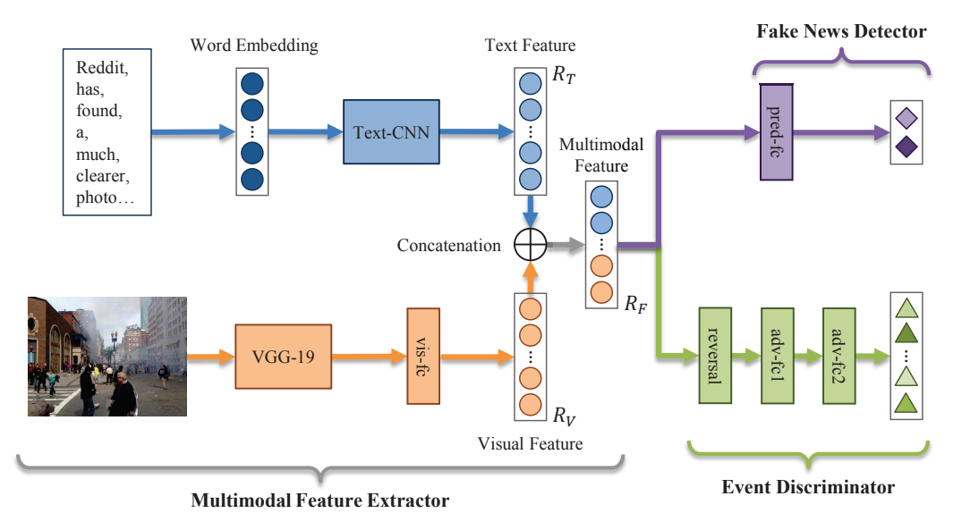
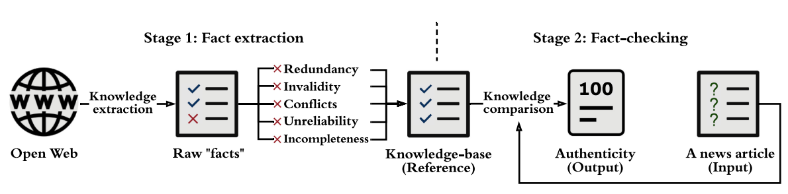
Classification Of Fake News
10.3% more accurate than the Att-RNN models on Twitter and Weibo.
Fake News Detection can be classified into 3 types-
Style, Knowledge, Propagation.
Style Based – Text, Image, Syntactical, Lexical.
Knowledge Based – Fact Extraction & Checking (Crowd based, Expert based & Automated).
Propagation Based – Dissemination of fake news
Notes:
Textual Feature Extractor:
Enhanced with convolution neural networks (CNN) and is very effective at classifying each word in the word embedding vector.
Text is vectorized and filtered, categorised, and grouped together.
Visual Feature Extractor:
This layer filter is effective in extracting images because it uses a pre-trained model to identify the images before fitting them into the matrix.
The main problem is that this neural network has only been tested on social media platforms like Twitter and Weibo and lacks the dataset and algorithmic capabilities to test for genuine published news stories
Manual fact-checking can be classified into two categories: (I) expert-based and (II)crowd-sourced fact-checking
PolitiFact and GossipCop are two of these websites that have assisted the creation of publicly accessible false news databases (e.g., LIAR datasets). These websites’ detailed expert-based analysis of checked contents (e.g., what is false and why it isfalse) provides useful insights for diverse components of fake news analysis, such as identifying check-worthy content and explainable fake news detection
Crowd-sourced fact-checking enlists the help of a huge number of ordinary people who act as fact-checkers (i.e., the collective intelligence). CREDBANK
Automatic fact check. Manual fact-checking does not scale with the volume of newly created information, especially on social media. To address scalability, automatic fact-checking techniques have been developed, heavily relying on IR, NLP, and ML techniques. It checks the redundancy on the basis of Subject Predicate Object and it is divided into Divided into Fact Extraction & Fact Checking.

Slide 14



Types of Propagation
Source Multiplier & Engagements
User Spreading the News, Classified based on friends, Followers, No. of shares, No. of Blocks Creation Date. Behavioral Aspect of the users, reaction, shares, Life of post being shared, marked as Spam.
Domain Origins
Credibility of the domain, News Channel, Co-Authorship, Biasness.
Propagation Patterns
Analysing movement of Fake News, Comments, repost, Vulnerable User, velocity of news.

Slide 15
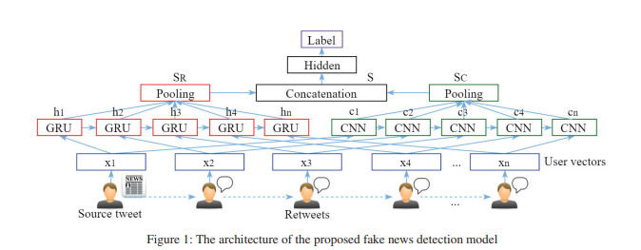
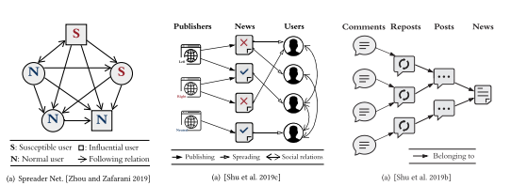
Availability of the research – Related works
Previously researchers have published Fake News Detection on the basis of –
Time difference between Post shares & Life Span.
Based on ‘Path Construction and Representation of Fake New’.
Relies Heavily of community ‘trend’ to decide Fake News.
Unable to Identify Unlabeled news or User posts spreading news.
Biasness of the News articles.
Based on providing bias report of Publisher, Target Audience.
Propagation based on audience sentiments, Analysing standard reaction & extreme sentiment post.
Unable to get accurate predictions for ‘Not American Countries’.
Propagation Diagram, Hierarchical, Homogeneous and heterogeneous Networks.
Involves farther Distance, Spreader Patterns, credibility of the post.
Basic means to study the how things propagate but has not diverse
conclusion

Slide 16
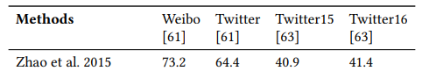
Accuracy of Related Works
1. Karishma Sharma, Feng Qian, He Jiang, Natali Ruchansky,
Ming Zhang, and Yan Liu. 2018- Propogation Diagram
2. Yang Liu, Yi-Fang Brook W – Early Fake News detection Based on time Span and propagation.
3. ilong Zhao, Jichang Zhao, Yukie Sano – Reposting User Relationship – SVM Classifer 79.5% Accuracy
4. Other techniques are survey taken to describe their Road Map. E.g. Fighting Fake News propagation with Blockchain – M Saad, A Ahmad.

Slide 17
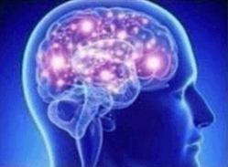
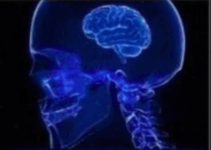

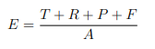
Source Multiplier & Engagement
Users Spreading Fake News can be a serious concern :–
Such type of users can be classified as –
1. Common Engager
2. Vulnerable User
3. Influential User
These users can be classified on the following data based on number of :-
1. Friends, 2. Followers, 3. Shares/Repost, 4. Posts, 5. Timeline of Post, 4. Block by Other Users/Marked as Spam 5. Comments, 6. Reaction/Likes.
Gathering Project user base Dataset from Kaggle.com with SVM Classifier as recommended by X. Zheng et al.
This method Appeals 99.5% Accuracy at 1:2, but when the Ratio of User to Spammers Drops.
Notes:
Where T, R, P, and F denote the number of tweets, retweets, replies and favorites by the user, respectively and A denotes the user account’s age in days.

Slide 18
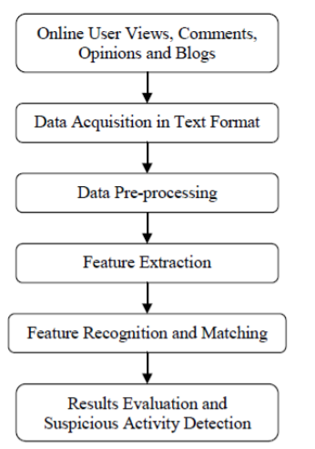
Source Multiplier & Engagement – Part 2
Other Models of Spammers Detection –
Effective Unified Weighted for Anomalous URL Detection – Based on User Interactions. Finds number of URLs spammers have done everyday.
Cascade Filtering Spam Detection – Detecting User’s Individual’s Social Environments, 2-Hop social network.
Spam Detection Using Text Mining – creating a compare matrix to detect spam comments of an online users. – Z. Zakia & S. Sadia 2017 Bagging Classifier 84% Acc.
Twitter spam bot detection – Using User environment, Duplicated tweets, No. of followers. Naïve Bayes 91.7% Acc.

Slide 19
Domain Credibility & Classification
Credibility of the domain can be determined by the following
1. News Media Platform - News Channels, Publishers and Co-authorship.
2. Biasness - Political views of the News articles.
3. Malicious Domains - Hostname and IP address, Web based features.

Slide 20
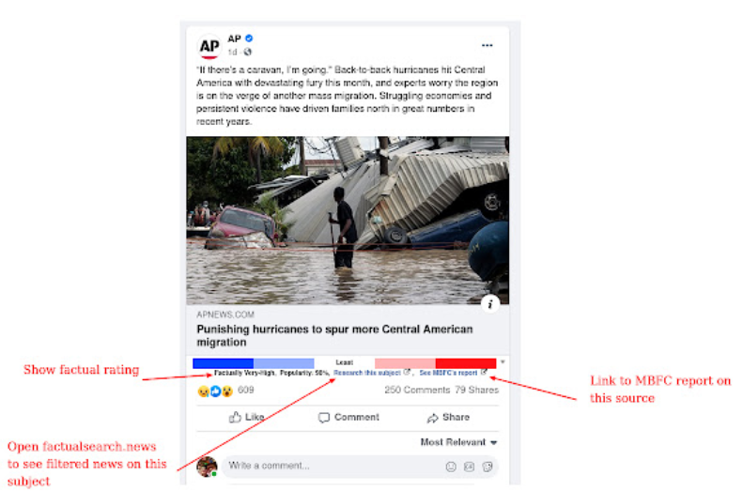
Domain Credibility & Classification (contd/-…)
1. News Media Platform & Biasness
Based on Credibility of the Publishers, Authors and Textual features.
Collection of crowd & expert sourced dataset from MEDIA BIAS https://mediabiasfactcheck.com/
Automated Fact checking is applied –
i. Compare the knowledge extracted from to-be-verified news content (i.e., SPO triples) with facts
ii. Where SPO triples (si,pi, oi ), i = 1, 2,...,n, GKB = true knowledge, Ai ∈ [0, 1] indicates true or False
iii. F : (si, pi, oi ) GKB→ Ai, In vectorize comparison with (stj ,ptj , otj ), j = 1, 2,...,m.
iv. A = I(A1,A2,...,An ), where I is a weight function.
v. F ((si, pi, oi ),GKB) = P (edge labelled pi linking s’i to o’i in GKB), where P() = probability
s’I = arg min |D(si, stj)| < θ and o’I = arg min |D(oi, otj)| < θ
Xinyi Zhou and Reza Zafarani. 2020. A survey of fake news: Fundamental theories, detection methods, and opportunities.ACM Computing Surveys(CSUR)53, 5 (2020), 1–40.
Notes:
extracted raw “facts,” they need to be further cleaned up and completed by addressing Redundancy Invalidity, Conflicts, unreliability and Incompleteness.
(DonaldTrump, bornIn, NewYorkCity) Vs (DonaldTrump, bornIn, LosAngeles) – Conflicts
(Britain, joinIn, EuropeanUnion) – Invalidity
(DonaldJohnTrump, profession, President) Vs (Donald- Trump, profession, President) Redundancy
Where D(a, b) is a cosin distance, if D(a,b) = 0, a as the same entity as b

Slide 21
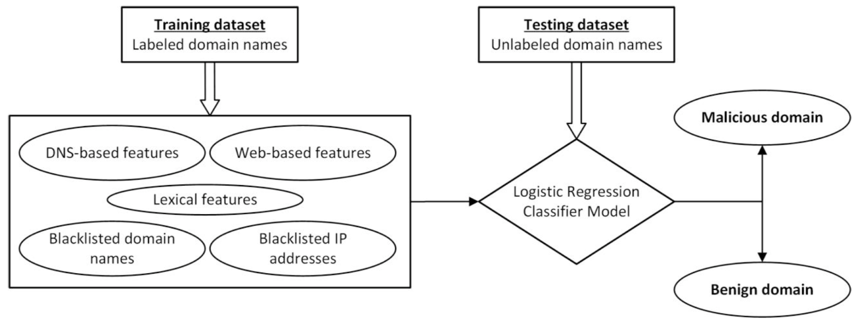
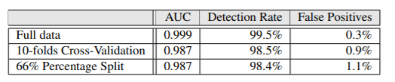
Malicious Domains
Malicious Domain Detection Using Machine Learning On Domain Name Features, Host-Based Features and Web-Based Features
Based on four features malicious domains were detected:
Blacklist of domain names and IP addresses collated from reliable and reputed resources,
DNS-based features extracted with support of various protocols which work on DNS infrastructure,
Web-based features. (Broken Links, Web referrals)
Lexical features. (Dots, Underscores, Digits)
e.g. I-go1-c0v-1d.co.in
Bilge, L., Kirda, E., Kruegel, C., & Balduzzi, M. (2016, February). Exposure: Finding malicious domains using passive DNS analysis. In Ndss (pp. 1-17).
Notes:
Palaniappan, Rajendran, Sanjay, Goyal, and B (2020) have done research on domain classification to classify the domain in terms of whether it has a valid SSL certificate or whether it has been blacklisted by search engines such as Google or Bing. It is a good idea to know the reputation of the domain before deciding where to place the article. This study demonstrates how attackers can switch DNS lookups by redirecting their IP address to another domain, making the website appear legitimate, and performing malicious activities on it. By inspecting active and passive DNS data logs and capturing IP addresses and hostnames associated with malicious activities and rumours . Fake news detection frequently involves cross-domain classification across platforms. To develop such a dataset, multiple domains of the same news topic are aligned and manually classified as fake or original. The problem is that there are number of different domains on the internet that broadcast the same news, making it even more difficult to categorise. As a result, some domains may even recommend that you visit malicious sites that the user is oblivious of and can sometimes damage and impair the user's computer.
(b) DNS-based features of a domain name: Domain Name System (DNS) plays a vital role in the functioning and maintenance of the WWW space. For a given domain name, we find all its host IP addresses, the Autonomous System Number (ASN), and hence also the countries or the areas where it is hosted. Determining the IP addresses helps us to classify the type of IP address, the geo-location of the IP address, and the type of connectivity at the region. The ASN helps us determine the Border-Gateway in which the hosting is present.
(c) Web-based features:
Attribute Description
Global and Country ranking Alexa, a popular ranking service, provides reliable ranking to websites based on
Webpages The number of webpages. More the number of webpages and lack of broken links ensures authenticity of the host
Time spent by visitor A visitor spending relative high time in the website improves authenticity of the host
Web referrals More the number of web referrals of a website in other Internet resources improves the credibility of the website
Web traffic (a) The consistency in the number of visitors to the website adds to the trustworthiness of the website
(b) Number of page views and
(c) amount of traffic reaching it through search engines
Category Identify the category or the subject matter to which the domain name belongs
Geo-location Geo-location of the IP addresses on which the domain name is hosted
(d) Lexical features:
Attribute Description
Dots Number of dots in the domain name should not be greater than 3
Underscores and hyphens Total count of underscores and hyphens in the domain name to be less than 4
Digits Count of number of digits in the domain name to be less than 4
Illegitimate contents We prepared a list of illegitimate words

Slide 22
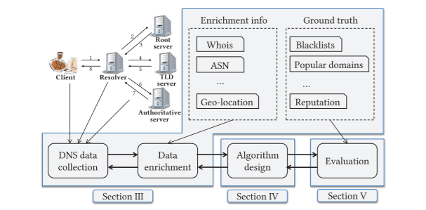
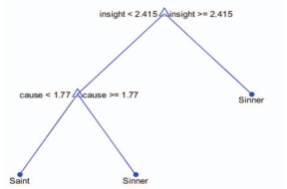
Previous Research on Domains
Zhauniarovich, Y., Khalil, I., Yu, T., & Dacier, M. (2018). A survey on malicious domains detection through DNS data analysis.
Based on DNS data, Geo Location, Malicious or not (from data source provided by SiteAdvisor, McAfee, Google Safe Browsing)
Focuses on network Spoof, IP redirect – or Clickbait
First, a malicious domain can be malignant in different ways & Heavy Reliance in ‘Blacklisted’ domains.
Deceptive Language-Action Cues. Ho, Shuyuan Mary, et al IEEE (2016)
Utilises textual analysis approach, to determine the credibility of the user.
Decision tree is used to determine number of words for truthfull teller's vs Decivers.
Issue with who the user is referring to in this classification because it is so highlevel.
Notes:
Deceptive Language. Once the data had been cleaned, the linguistic cues from the data were extracted according to the categories established in the Linguistic Inquiry and Word Count (LIWC) tool .These data were processed, analyzed and calculated first on a percentage basis and then on a word-count basis.

Slide 23
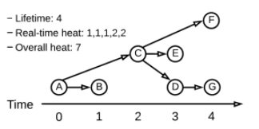
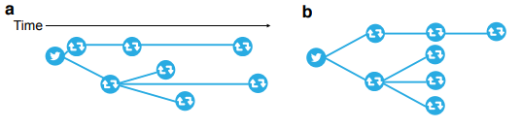
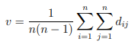
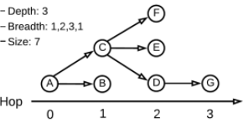
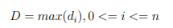
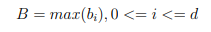
Propagation Networks
1. Lifetime: the longest interval during which the news has been propagated;
2. Real-time heat (at time t): the number of users posting/forwarding the news at time t; and
3. Overall heat: the total number of users who have forwarded/posted the news.
Structural Virality: The structural virality of a cascade, as is the average distance between all pairs of nodes in a cascade
Depth: The depth of a node is the number of edges from the node to the
Max-Breadth: the number of users who have spread the news.
1. Depth: the maximum number of steps (hops) that the news has traveled within a cascade;
2. Breadth (at hop k): the number of users who have spread the news k steps (hops) after it
was initially posted within a cascade; and
3. Size: the total number of users in a cascade.
Notes:
measured and compared four static characteristics of false, true and mixed rumor cascades: depth, max-breadth, structural virality [23], and size (since on Twitter a person can only retweet a tweet once, the size of a cascade corresponds to the number of unique users involved in that cascade
Virality --- For a cascade with n>1 nodes, the virality v ,,, dij denotes the length of the shortest path between nodes i and j
the depth of a cascade, D, with n nodes is Where di denotes the depth of node I
. In other words, the depth of a cascade, D, with n nodes is defined as ,.,..,.,.,., here di denotes the depth of node i.
For a cascade with depth d, the max-breadth, B, Where bi denotes the breadth of a cascade at depth i.

Slide 24
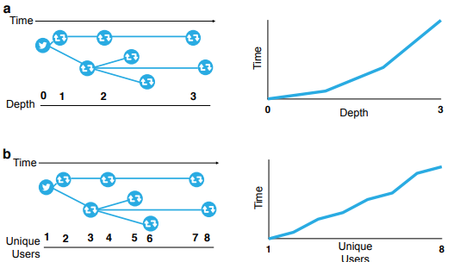
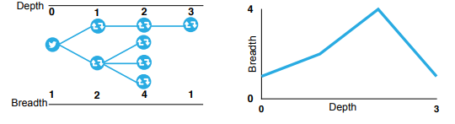
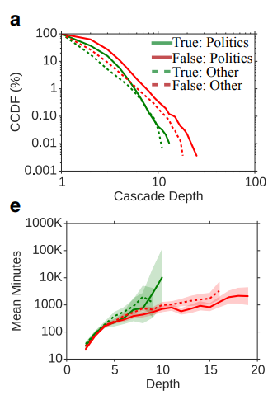
Propagation Networks (contd/-….)
Time vs Depth
Time vs Unique User (Virality)
Depth vs Breadth
Notes:
TIME VS Depth - For each depth, we averaged these times across false, true and mixed cascades, producing an average time
Unique Users over Time - For each value, we averaged these times across all false, true and mixed cascades, producing an average time (and standard error) for cascades to reach different numbers of unique users.
Breadth vs Depth , producing an average breadth (and standard error) for each depth

Slide 25

Future Research

Slide 26
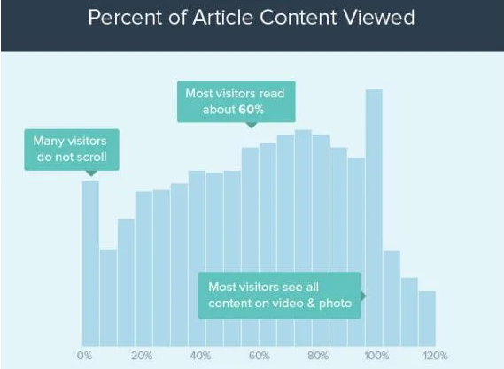
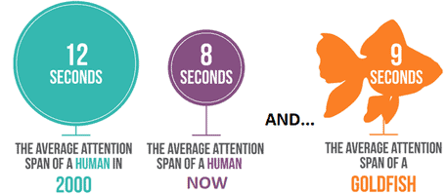
Addition of Sentimental Analysis
Transmission of News, by reinterpretations of the news.
WHY this?
“Study: 70% of Facebook users only read the headline of science stories before commenting.”
-By Caitlin Dewey June 16, 2016 Washington Post. https://www.washingtonpost.com/news/the-intersect/wp/2016/06/16/six-in-10-of-you-will-share-this-link-without-reading-it-according-to-a-new-and-depressing-study/
Notes:
So basically, saying Americans are dumb and they can’t read? No, we don’t have time for ourselves to get in depth of the news. So we need better solutions to segregate the fake news from the News so people can trust the news and carry on with their lives.

Slide 27
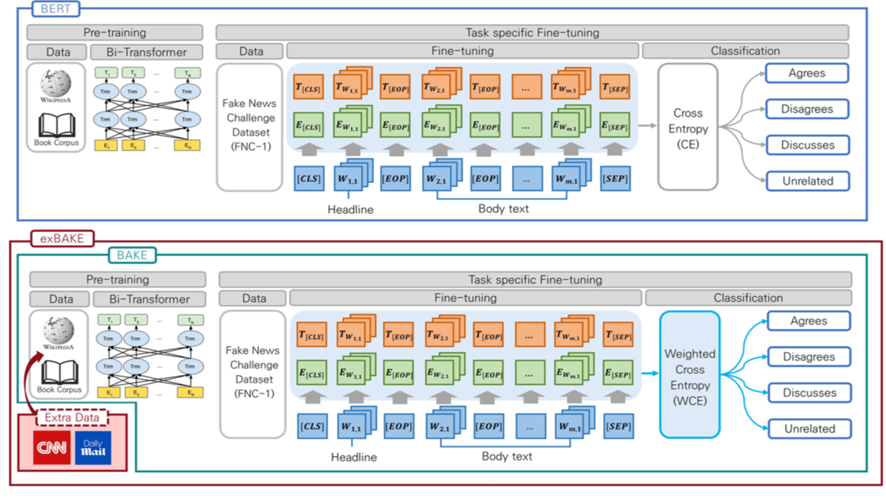
Addition of Sentimental Analysis
exBAKE: Automatic Fake News Detection Model Based on Bidirectional Encoder Representations from Transformers (BERT)
BERT is used which includes pre-training language representations developed by Google.
Researchers found that the data was unstable, and therefore proposed to develop the BAKE model to classify the data using Weighted Cross Entropy (WCE).
CNN and Daily Mail news data were used for BAKE pre-training.
Finally,the performance of the proposed model exBAKE was evaluated.
Results indicated that the model worked best on the FNC-1 dataset, which detected fake news by analyzing the relationships between headlines and the corresponding body texts of news articles.
Notes:
In this paper, we propose BAKE, an automatic fake news detection model that improves upon BERT by mitigating the data imbalance problem. Furthermore, we also propose a model that incorporates extra unlabeled news copora into BAKE, which we term exBAKE.

Slide 28
More to come..
Adversarial change in the propagation to fool the classifier’s outcome
Addition of more adversarial attacks on propagation

Slide 29

Questions?

